Slide 1
Fuzzification and De-fuzzification

Slide 2
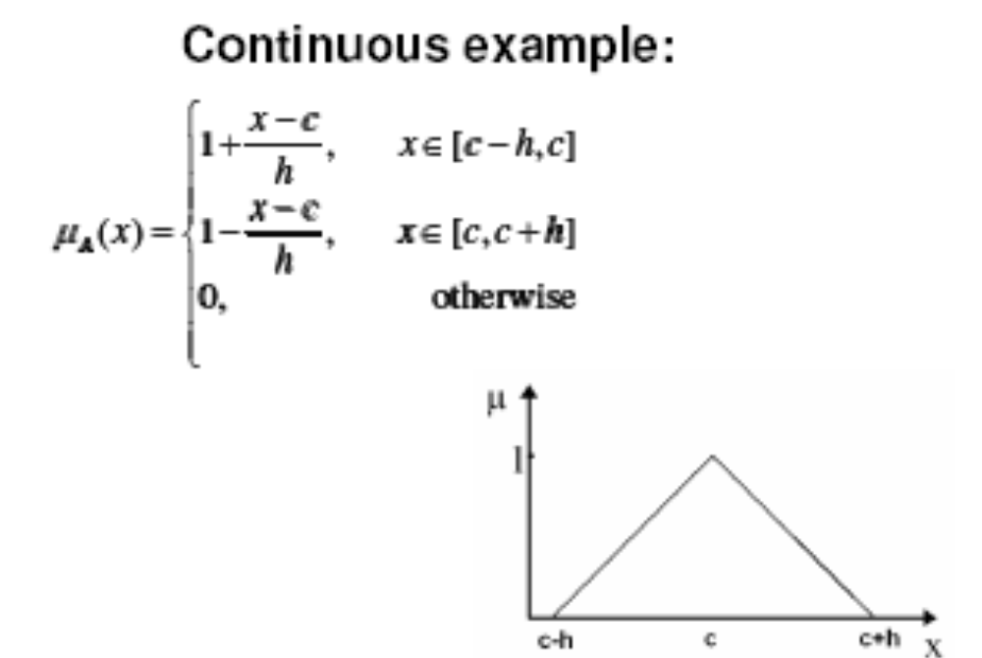
Membership Function of a fuzzy set
All information contained in a fuzzy set is described by its membership function.
For Simplicity we take continuous fuzzy sets.

Slide 3
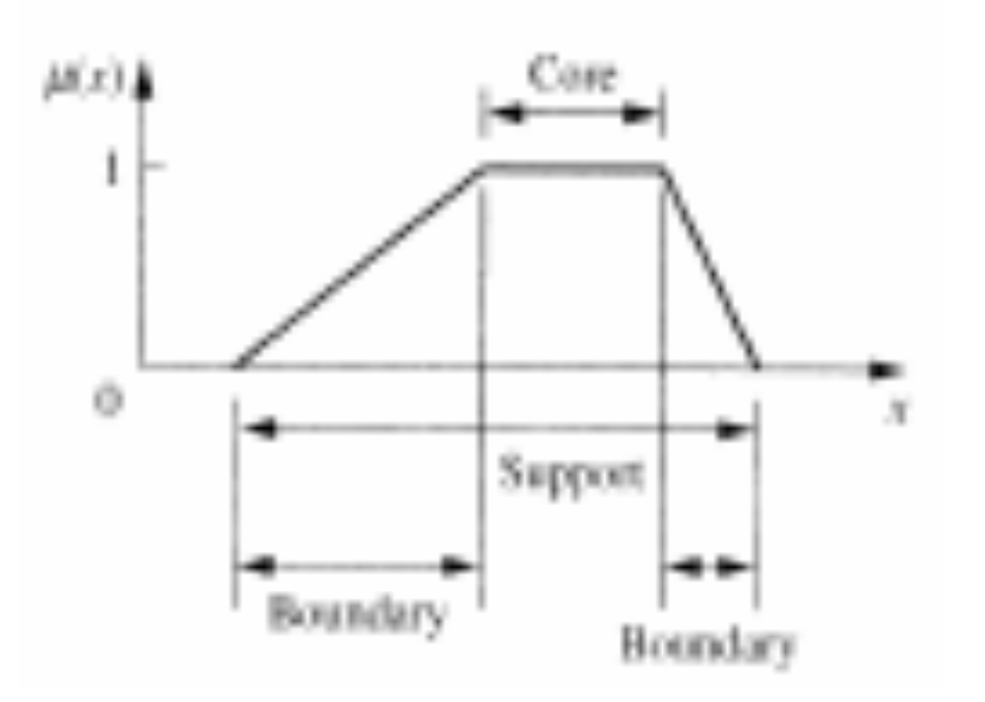
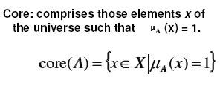
Properties of Membership Function

Slide 4
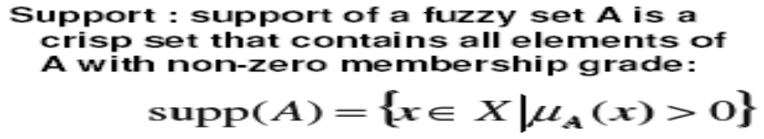
Properties of Membership Function

Slide 5
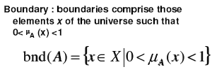
Properties of Membership Function

Slide 6
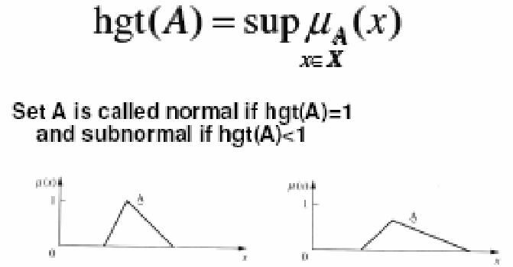
Properties of Membership Function
Height of a fuzzy set A, hgt (A) or h (A) is the largest membership grade obtained by any element in that set.

Slide 7
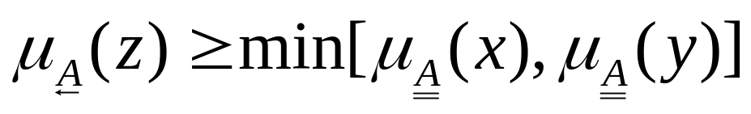
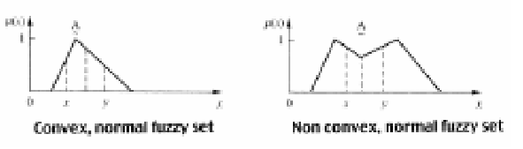
Properties of Membership Function
A convex set is described by membership function whose membership values are:
  Either strictly increasing or decreasing.
  Or specifically strictly monotonically increasing then strictly monotonically decreasing.
  For any values of x, y, z in fuzzy set A, the relation x<z<y implies that,
  Then the set A is convex set.
  Also if A and B are convex then A ∩ B is also convex.

Slide 8
Fuzzification
Process of making a crisp quantity fuzzy.
Following are some of the methods of assigning membership values or functions to fuzzy variables.
  Intuition
  Inference
  Rank Ordering
  Angular fuzzy sets
  Neural Networks
  Genetic Algorithms
  Inductive reasoning
  Soft Partitioning
  Meta rules
  Fuzzy statistics.

Slide 9
Fuzzification
Intuitive Approach
  From Human experience.
  From knowledge base.
  From a detailed study of the system in hand.
μ
1
Very Cold
Cold
Cool
Warm
Hot
Very Hot
0 20 40 60 80 100

Slide 10
Fuzzification
Inference Approach
  We use knowledge to perform deductive reasoning.
  We deduce or infer a conclusion.
Family of Triangles Example
  Let
    I is a set of fuzzy isosceles triangle
    R is a set of fuzzy right triangle
    IR is a set of fuzzy isosceles and right triangle
    E is a set of fuzzy equilateral triangle
    T is a set of other fuzzy triangles
  The universe of discourse is defined as

Slide 11
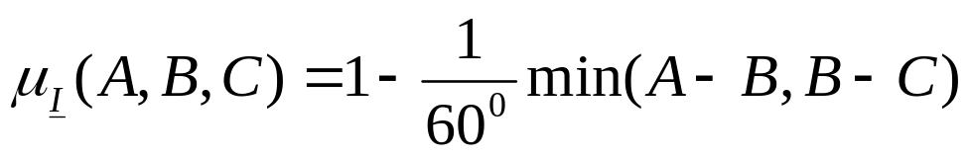
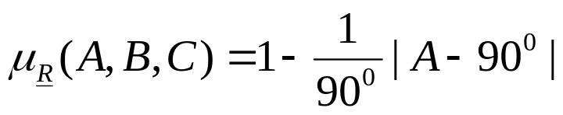
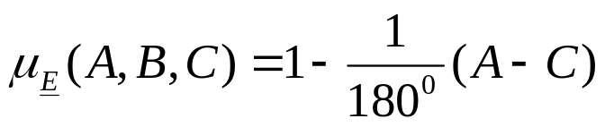
Fuzzification

Slide 12
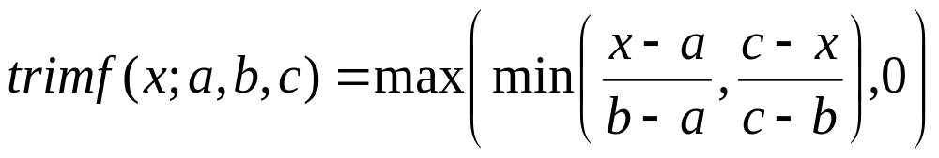
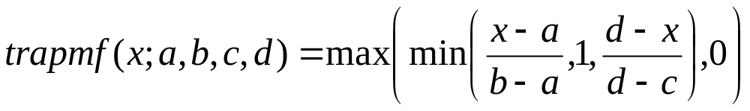
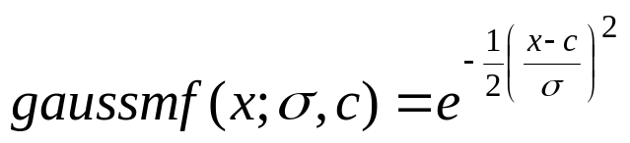
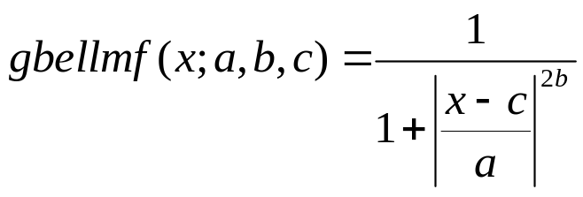
Different MF Forms
Triangular MF
Trapezoidal MF
Gaussian MF
Generalized bell MF

Slide 13
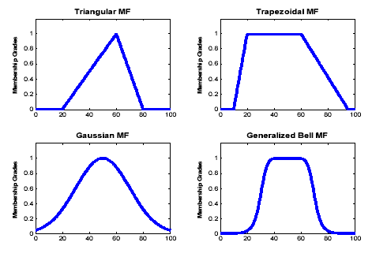
Different MF Forms

Slide 14
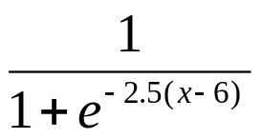

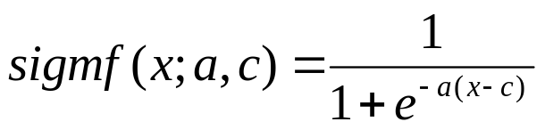
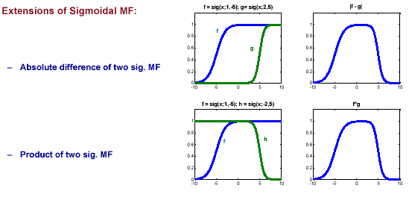
Sigmoidal MF

Slide 15
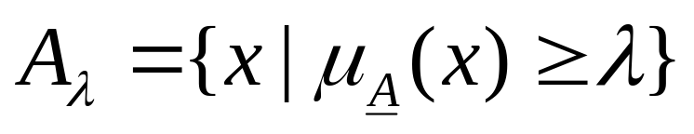
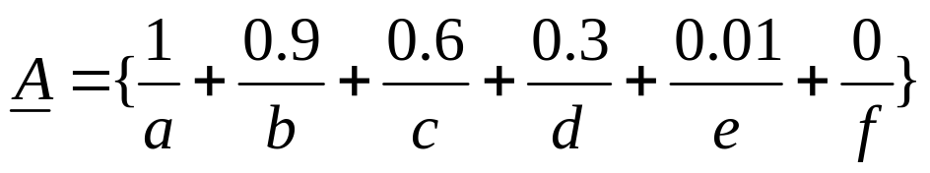

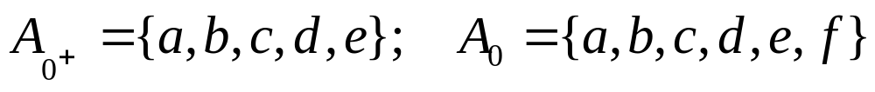
λ-cuts or α cuts for fuzzy sets
  [1 ≥λ ≥ 0]
  A λ-cut set is a fuzzy set containing elements with membership values greater than λ.
  Any element x ∈A_{λ} belongs to A with μ ≥ λ.

Slide 16
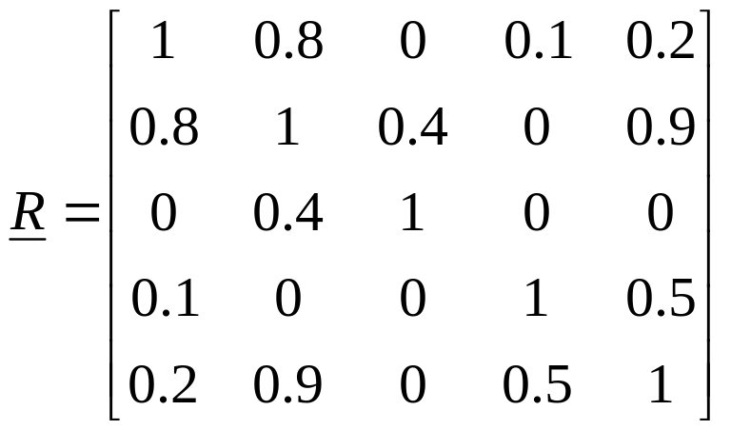

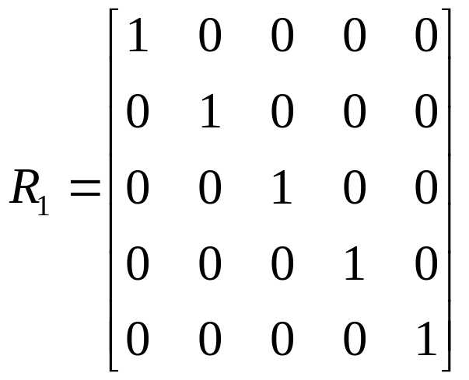
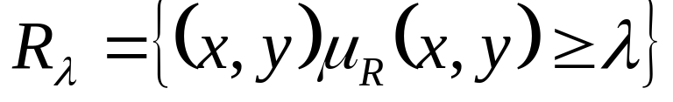
λ-cuts for Fuzzy Relations
If R is a two-dimensional array defined on the universe X and Y, then any pair (x,y)∈R_{λ} belongs to R with a strength of relation gerater than or equal to λ.

Slide 17
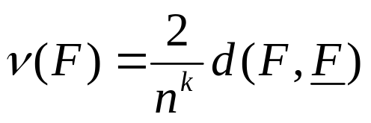
λ-cuts for Fuzzy Sets & Relations
Any λ-cut set of a fuzzy set is referred to as the nearest ordinary set to the fuzzy set.
Any λ-cut relation of a fuzzy relation is referred to as the nearest ordinary relation to the fuzzy relation.
The distance d between a fuzzy set F and its nearest ordinary set F is referred to as the index of fuzziness. It is given as
where k depends on the type of distance used.

Slide 18
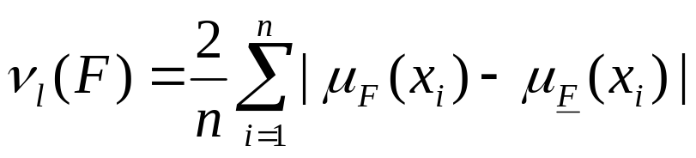
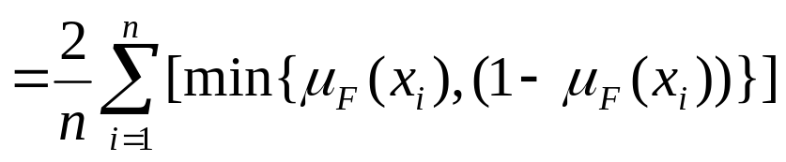
λ-cuts for Fuzzy Sets & Relations
k = 1 is used for generalized Hamming distance.
The corresponding index of fuzziness is referred to as the linear index of fuzziness. It is given by
Higher values of k gives higher orders of the index of fuzziness.

Slide 19
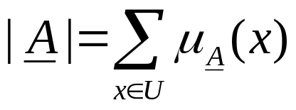
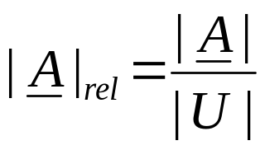
Cardinality of a Fuzzy Set
The cardinality (scalar cardinality) of a fuzzy set A is the summation of the membership grades of all elements in the set A.
It is given by
The relative cardinality of A is

Slide 20
DeFuzzification Methods
The process of obtaining back the crisp values from the fuzzified state.
It involves the conversion of a fuzzy quantity to a precise quantity.
Several methods for defuzzifying fuzzy output:
  Max-membership principle
  Centroid method
  Weighted average method
  Mean-max membership
  Centre of sums
  Center of highest area
  First (or last) of maxima

Slide 21

Max-membership principle
  Also referred to as height method.
  Limited to peak output functions.
μ
1
z* z

Slide 22
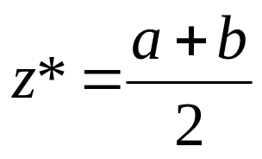
Mean-max membership method
  Also referred to as the middle-of-maxima method.
  Similar to max-membership method, but the locations of the maximum membership can be non-unique.
  The maximum membership can be a plateau rather than a single point.
μ
1
a z* b z

Slide 23
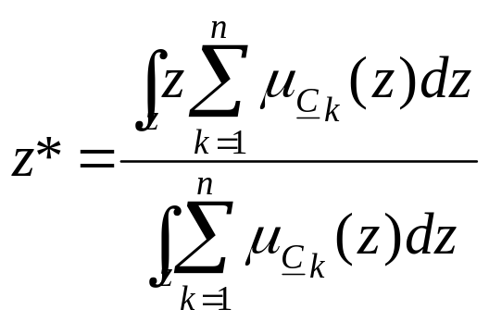
Center of sums method
  A faster method.
  Involves algebraic sum of individual output fuzzy sets instead of their union.
  The drawback is that the intersecting areas are added twice.
1
μ
0.5
0 2 4 6 z* 8 10 z

Slide 24
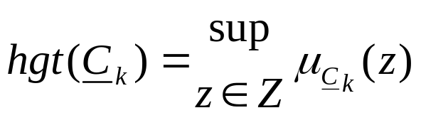
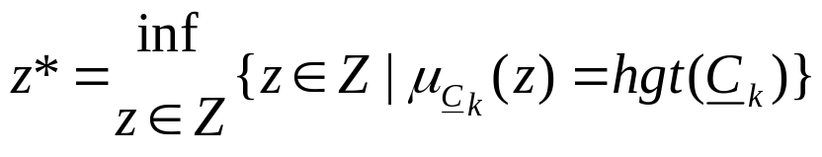
First (or last) of maxima method
  Uses the overall output or union of all the individual output fuzzy sets C_{k} to determine the smallest value of the domain with maximized membership degree in C_{k}.
  Step 1:
    The largest height in the union [denoted by hgt(C_{k})] is determined by
  Step 2
    The first maxima is found by
Supremum is the least upper bound
Infimum is the greatest lower bound

Slide 25
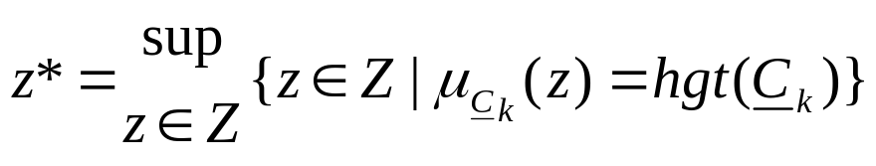
  Or Step 2:
    The last of maxima is determined by
μ
1
0.5
z* z

Slide 26
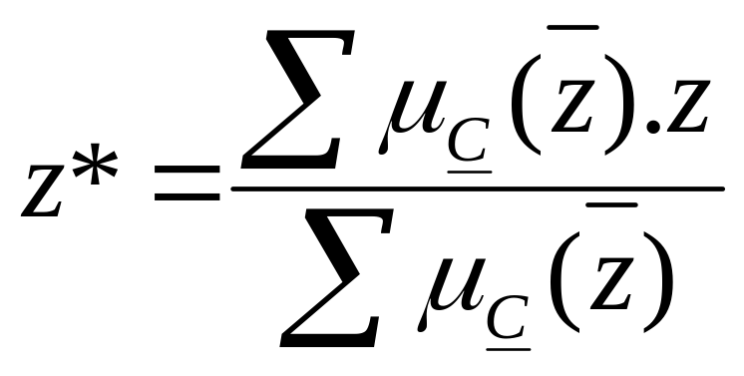
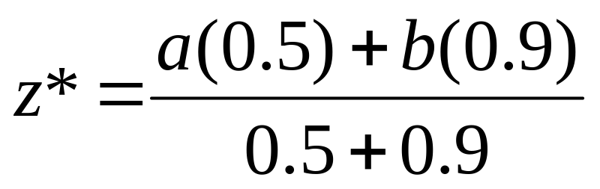
Weighted average method :
Valid for symmetrical output membership functions
a and b are values of means of
their respective shapes.
a
b

